Slide 1
SPAM CLASSIFICATION
PRESENTED BY:
RUTUJA PATIL

Slide 2
INDEX
Overview
Problem Statement
Problem Understanding
What is Spam Classification?
Importance of Spam Classification?
Exploratory Data Analysis
Visualizations
Analysis
Data Cleaning Steps
Model Building
Hyper Parameter Tuning
Saving model & predictions for Best Model
Conclusion and Test Prediction.

Slide 3
OVER VIEW FOR PREDICTION
In this Presentation we will be looking on the :
How to analyze the dataset of Spam Classifier.
EDA steps in cleaning the dataset.
Overall analysis on the problem.
Model building from the train dataset.
Predicting on the Data Set.

Slide 4
PROBLEM STATEMENT
Spam Detector is used to detect unwanted, malicious and virus infected texts and helps to separate them from the non-spam texts. It uses a binary type of classification containing the labels such as ‘ham’ (non-spam) and spam. Application of this can be seen in Google Mail (GMAIL) where it segregates the spam emails in order to prevent them from getting into the user’s inbox.
The files contain one message per line. Each line is composed by two columns: v1 contains the label (ham or spam) and v2 contains the raw text.
THIS PROJECT CONTAINS TWO PHASE
TRAIN DATA SET
TESTING ON THE SAME DATA-SET

Slide 5

WHAT IS SPAM CLASSIFICATION?
Spam is any kind of unwanted, unsolicited digital communication that gets sent out in bulk. Often spam is sent via email, but it can also be distributed via text messages, phone calls, or social media.
Spam classifier machine learning model is need of the hour as everyday we get thousands of mails ,sms and don’t have time to manually reject each spam.
Hence by using this spam classifier we can get rid of mail segregation, as computer trained model does the same thing by detecting the fraud mails for us so that we can be spam free

Slide 6
EXPLORATORY DATA ANALYSIS :
As a first step I have imported required basic libraries along with natural language processing libraries, and imported the train which were in csv format.
Then I did all the statistical analysis of the data set and checked shape, size and uniqueness (unique value) of each column, Names were assed to columns.
The data types were checked, along with the value counts Followed by visualization.
Duplicated rows were checked, and found 403 rows to be duplicated.
Null values were checked and we calculated the missing percentage of the datasets of each columns. However the missing contents were more than 90 percent, We dropped those rows.
Finally visualization were performed on the missing data.

Slide 7
EXPLORATORY DATA ANALYSIS
Exploratory data Analysis was performed on the basis of univariate analysis, bivariate analysis, Multivariate Analysis.
To understand the classification of spam and non-spam. We calculated the length of texts, length of words, length of sentences.
We have used replace method and renamed ham as 0 and spam as 1.
Visualization were performed by using count-plot, bar-plot, hist-plot.
Pearson Correlation was used in multivariate graph
Descriptive and Correlation was checked for the same and found high correlation with words and sentences

Slide 8
EXPLORATORY DATA ANALYSIS :
The Outliers, Skewness were checked for the data.
we used preprocessing method such as data cleansing.
Lowering text
Using English stop words
Using string . punctuation
Using Stemming process
Joining Corpus
We used Word Clouds to find maximum used words in messages in ham and spam
We used counter library to take a visualize frequent used words
We used bag of word to convert the independent variable into vectors

Slide 9
EXPLORATORY DATA ANALYSIS :
Model Building was performed by importing important libraries.
The train test was performed on that imbalanced data.
Selected random state as 4 as the precision score was almost 100 percent.
Naïve Baiye Classifier was used, however the precision score was not to good to we moved with other models.
Hyper-Parameter tunning was performed
Saving Model

Slide 10
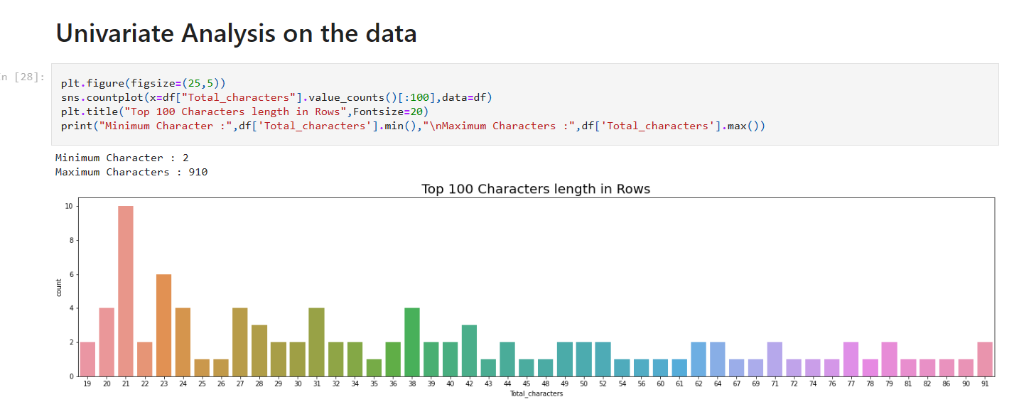
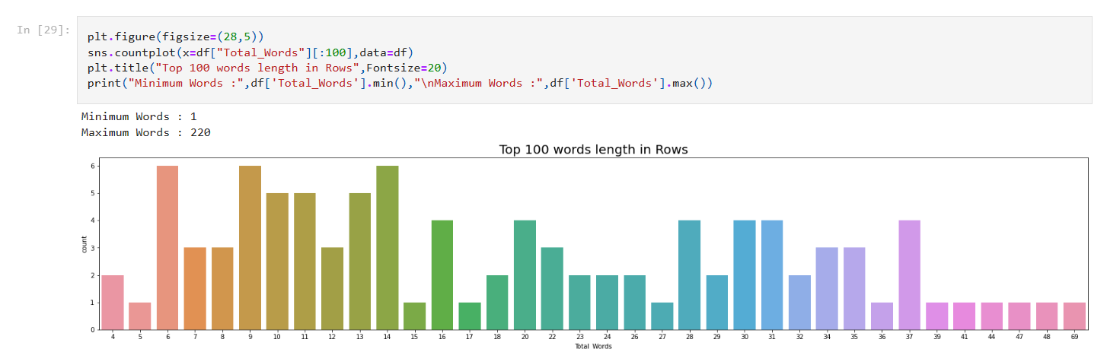
FEW VISUALIZATION

Slide 11
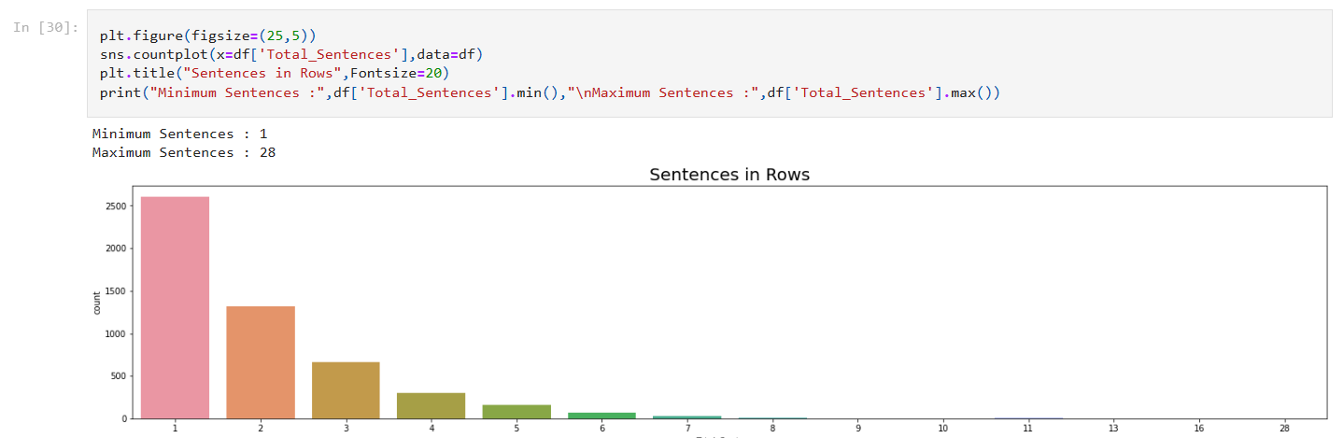
FEW VISUALIZATION

Slide 12
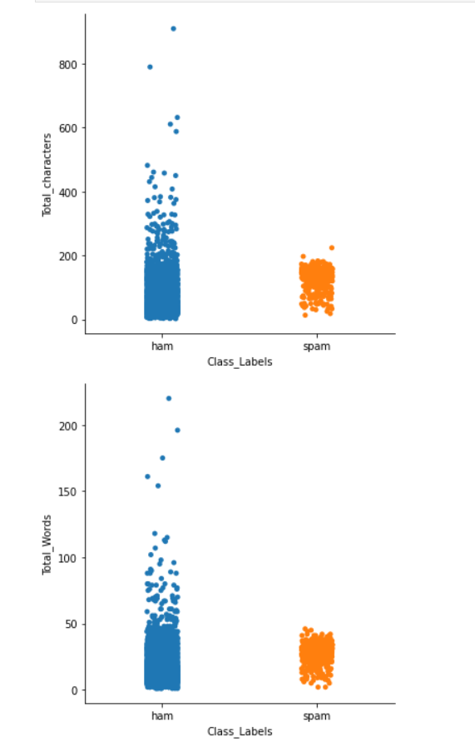
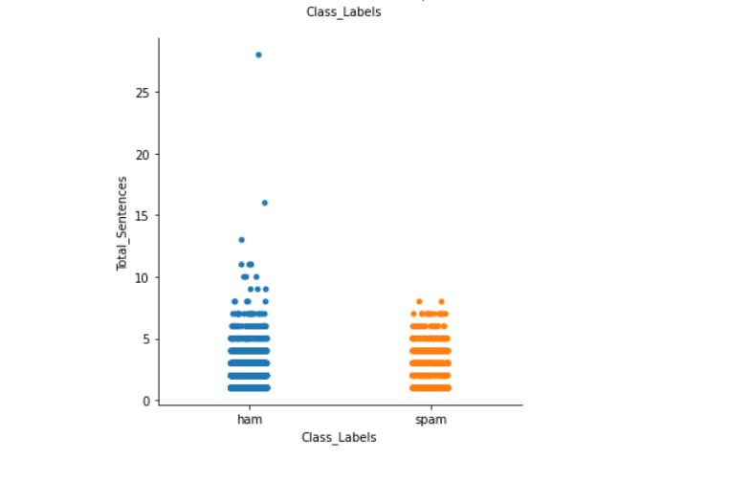
FEW VISUALIZATION

Slide 13
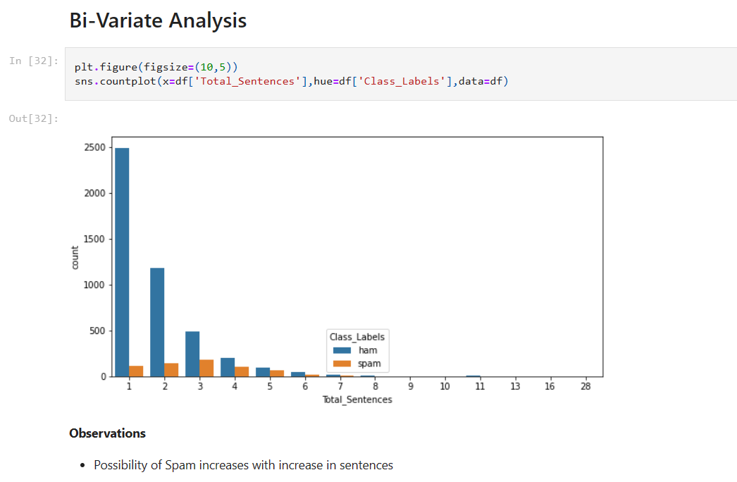
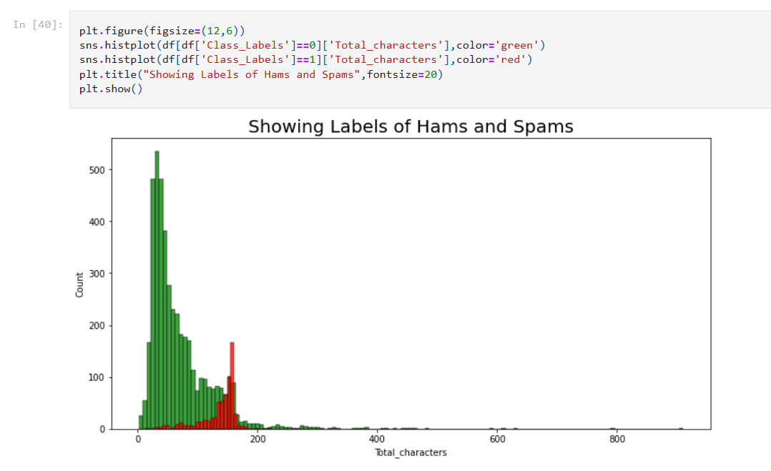
FEW VISUALIZATION

Slide 14
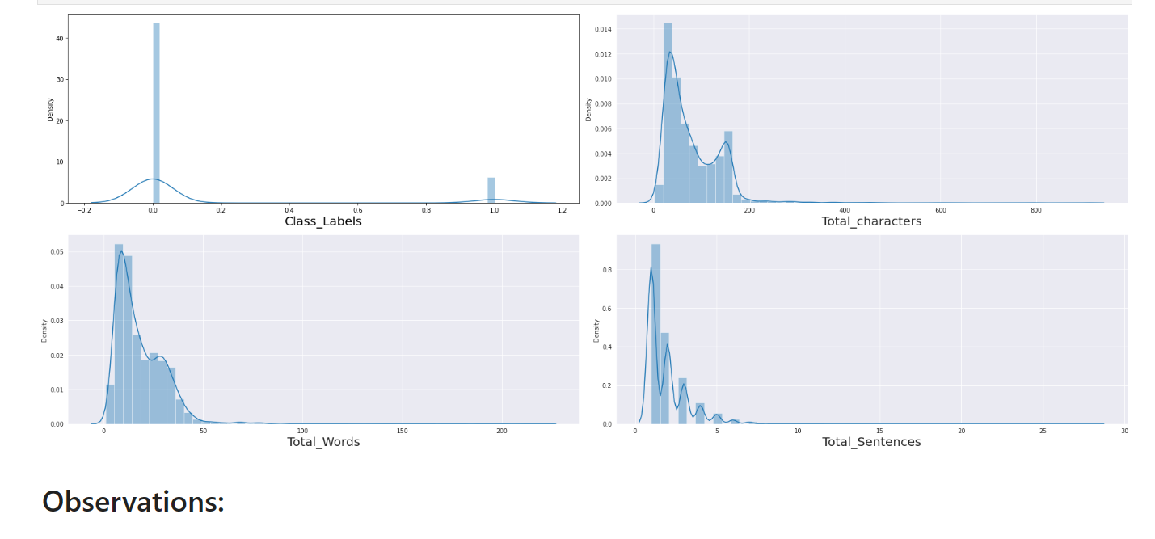
FEW VISUALIZATION

Slide 15
Observation:
Column consist of 5572 rows and 5 columns, 2D data with 218kb size.
Almost more than 90 percent data is missing in the 3 columns and those were dropped.
Found 403 Duplicated Row, Hence dropped
Rude column shows 4516 HAM and 653 SPAM
Length of Total Characters, Total Words, Total Sentences.
Total Characters shows maximum spam between 140 to 180.
Total Words shows Maximum lies between 40 to 47 words.
Maximum spam sentences likes at 3.
Total Words and Total Sentences are highly correlated with target

Slide 16
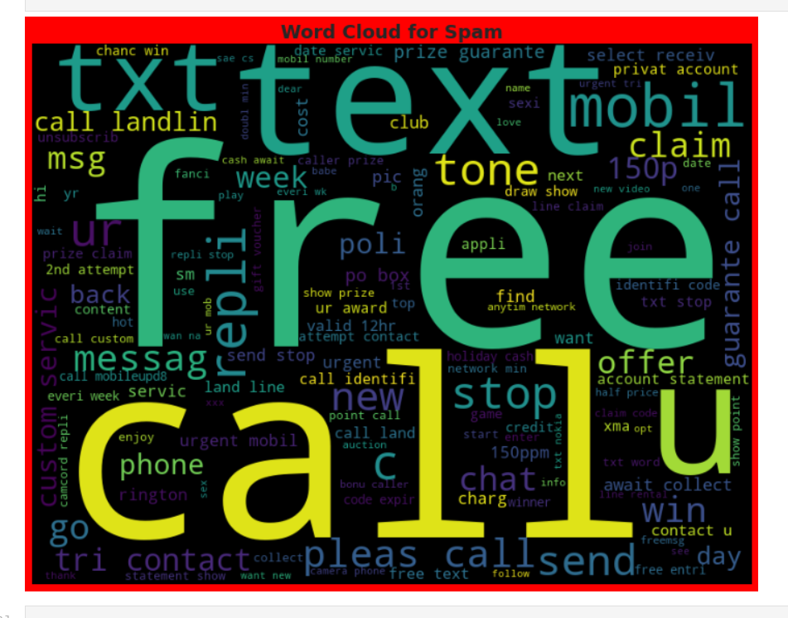
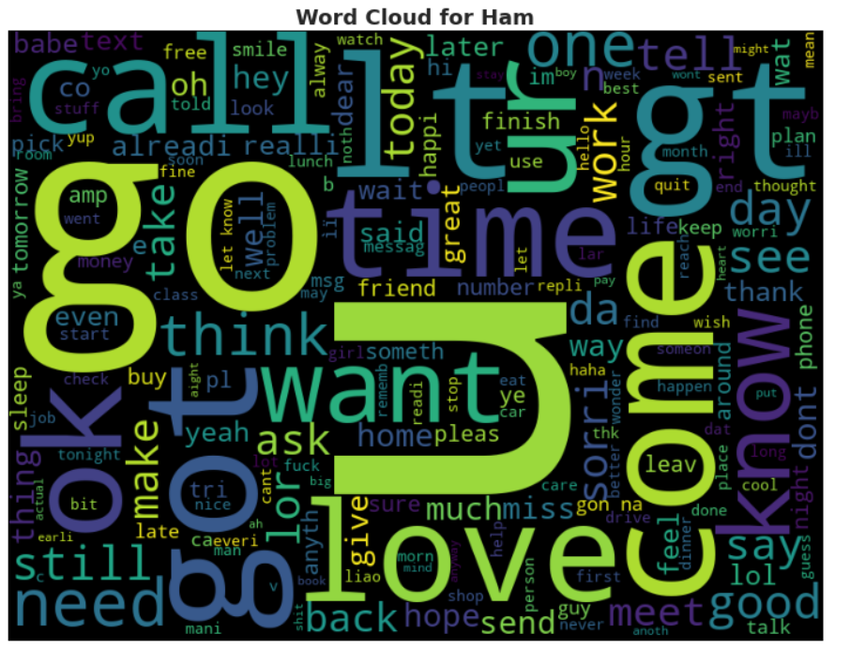
FEW VISUALIZATION

Slide 17
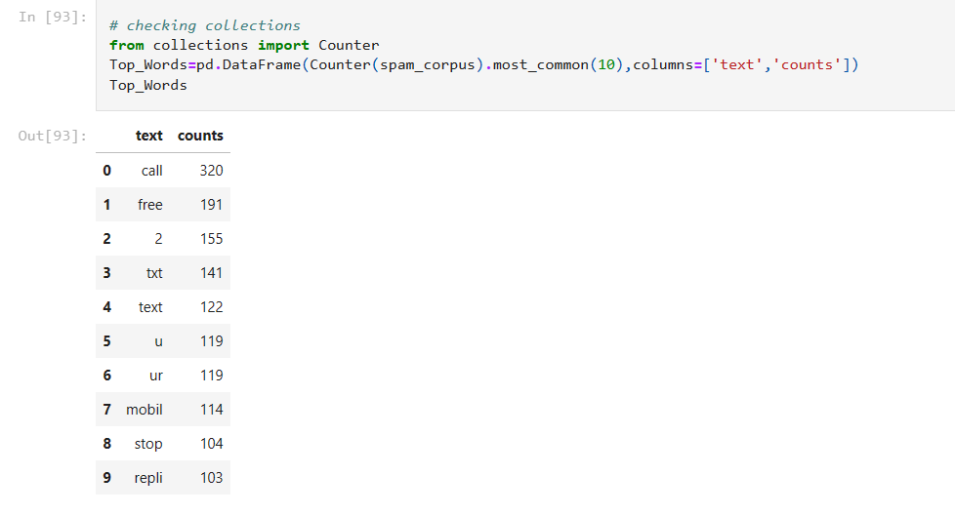
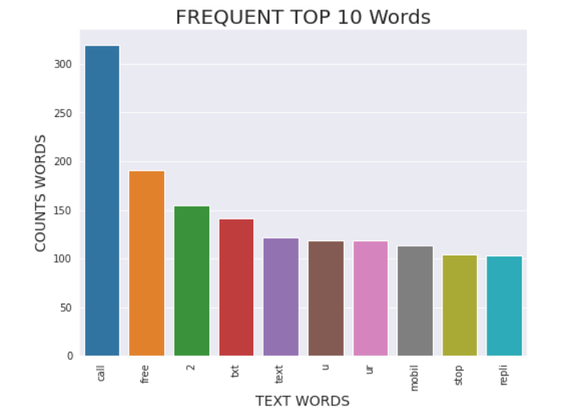
Observation

Slide 18
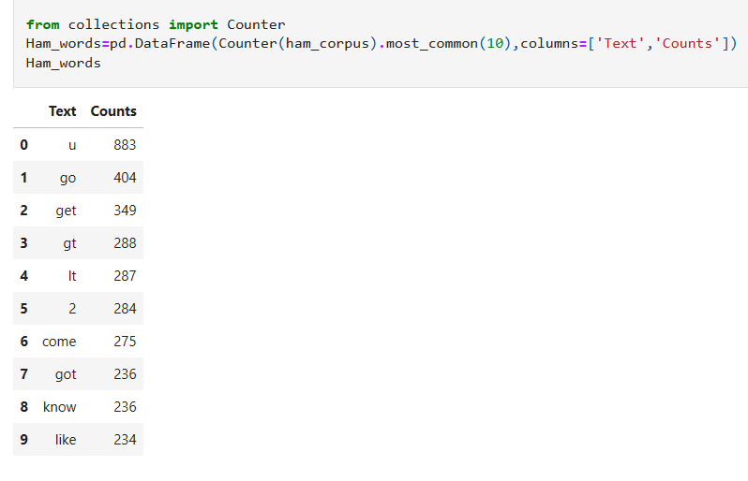
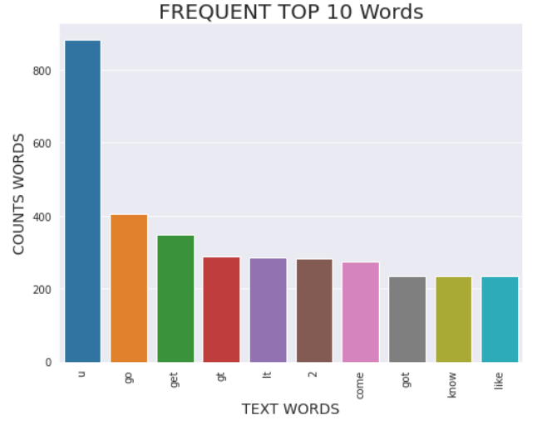
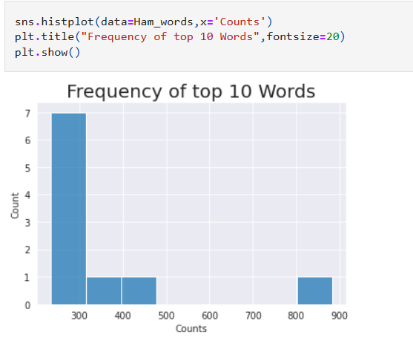
HAM CORPUS

Slide 19
DATA ANALYSIS
I have used count plot , bar plot and cat plot to show the relationship between numerical variable.
Other than these, I used Word Cloud to see the frequency of words. In each columns and found maximum contains of those words within.
I have used NLTK library for Natural Language processing. The other than key was used while removing all the abnormal symbols from target variable.
I found the contains of distribution with the help of Pie chart. An Extra bar graph was also drawn to show the distribution.
We have focused on the length of words, sentences and characters while working with data set
Stop words was also used with string punctuation words to make the system more ready for classification.
We have used Stemming for SMS classification as that help model to work in more better way.
We used (bag of words) count vectorizer was used for vectorization.

Slide 20
STEPS INVOLVED
Since Class Label was my target variable and it was a categorical column which I converted to 0 and 1.
However target variable has two value counts So this particular problem was Logistic regression problem and I have used all Classification algorithms to build my model.
I tried to focus more on NAÏVE Based models, However the precision was not good we used other models to get the best.
By looking into the difference of PRECISION_ SCORE and accuracy score and cross validation I found Logistic Regression Model and MLP classification model as a best model..
We used hyperparameter and increased the efficiency of few numbers. And finally saved the logistic Regression Model..

Slide 21
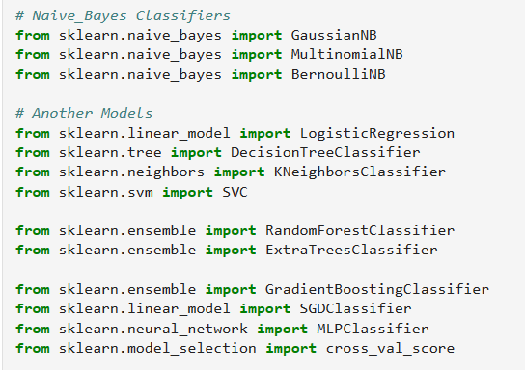
ALGORITHMS I HAVE USED IN MY PROJECT

Slide 22
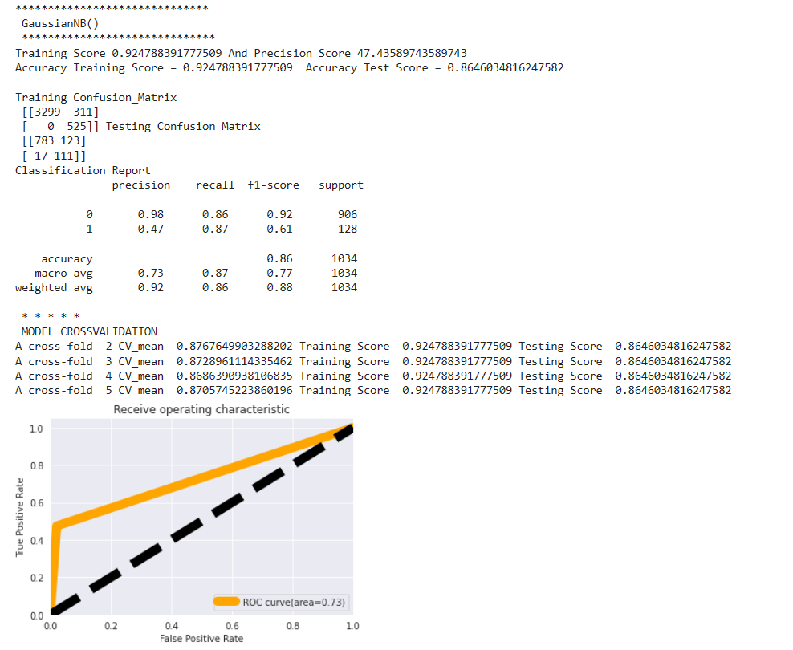
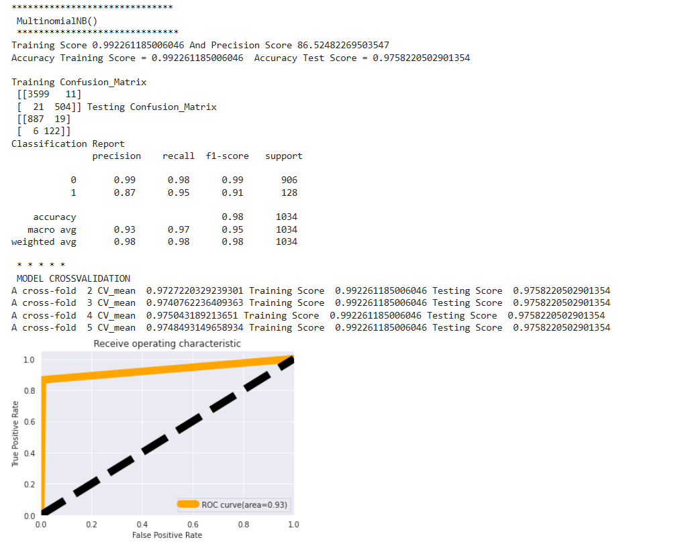
DIFFERENT MODELS WITH THEIR PERFORMANCE:

Slide 23
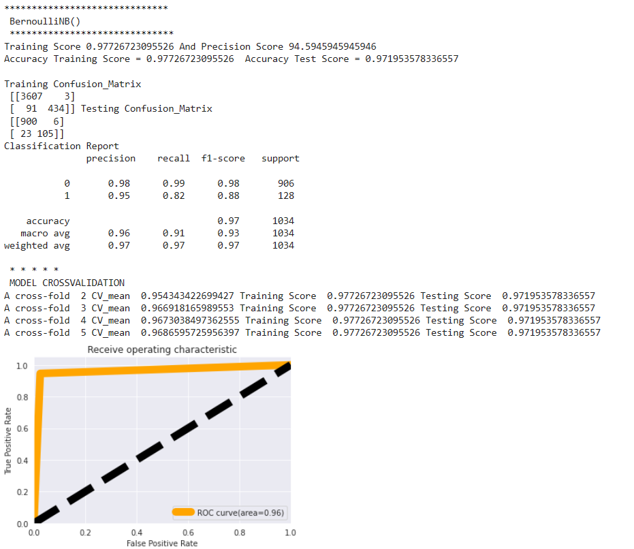
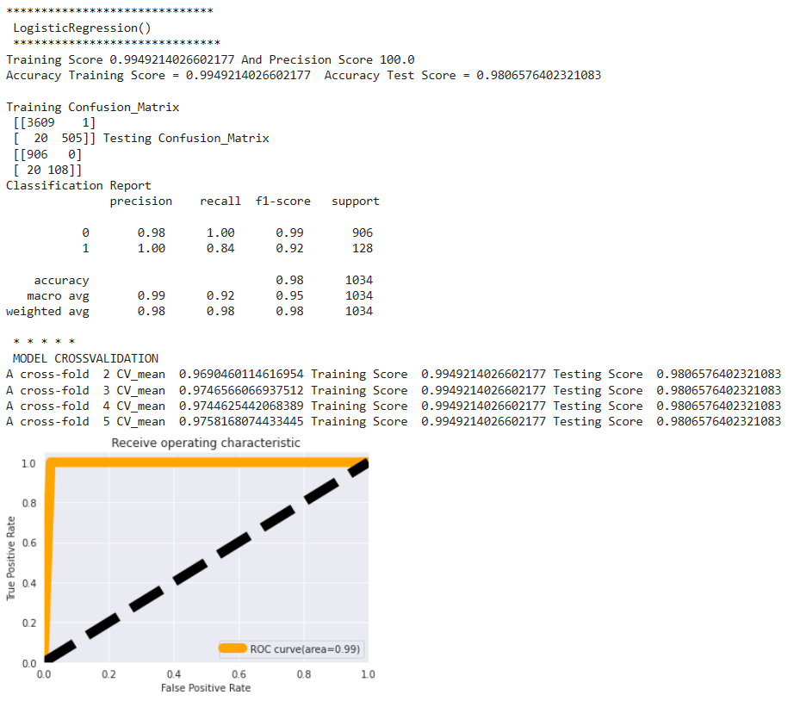
DIFFERENT MODELS WITH THEIR PERFORMANCE:

Slide 24
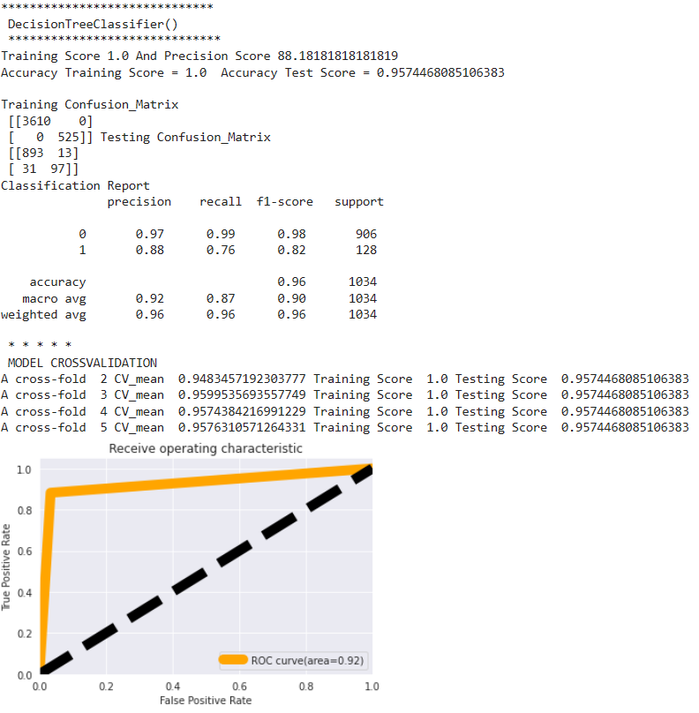
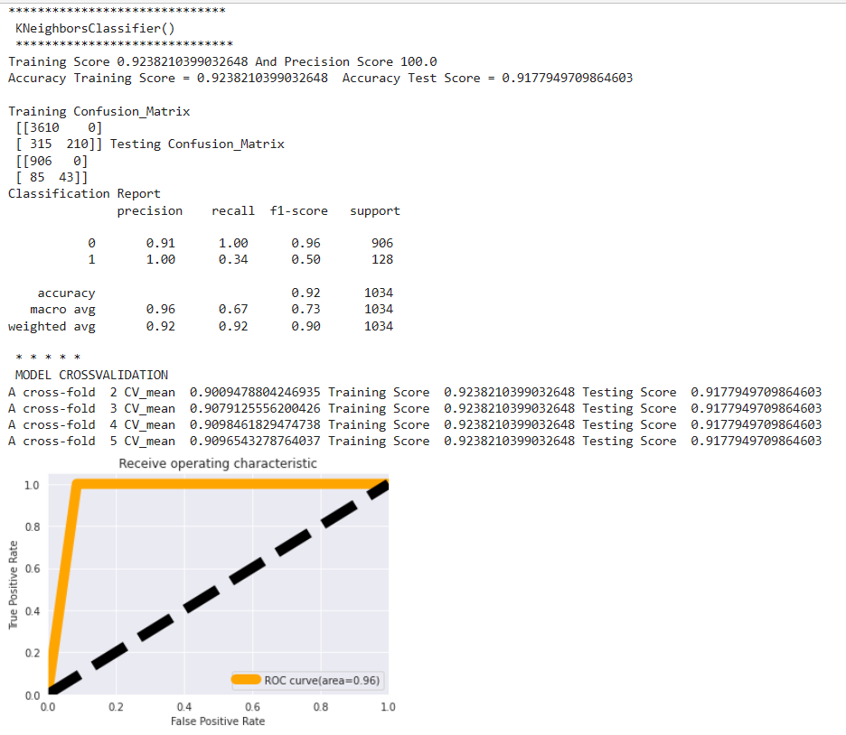
DIFFERENT MODELS WITH THEIR PERFORMANCE:

Slide 25

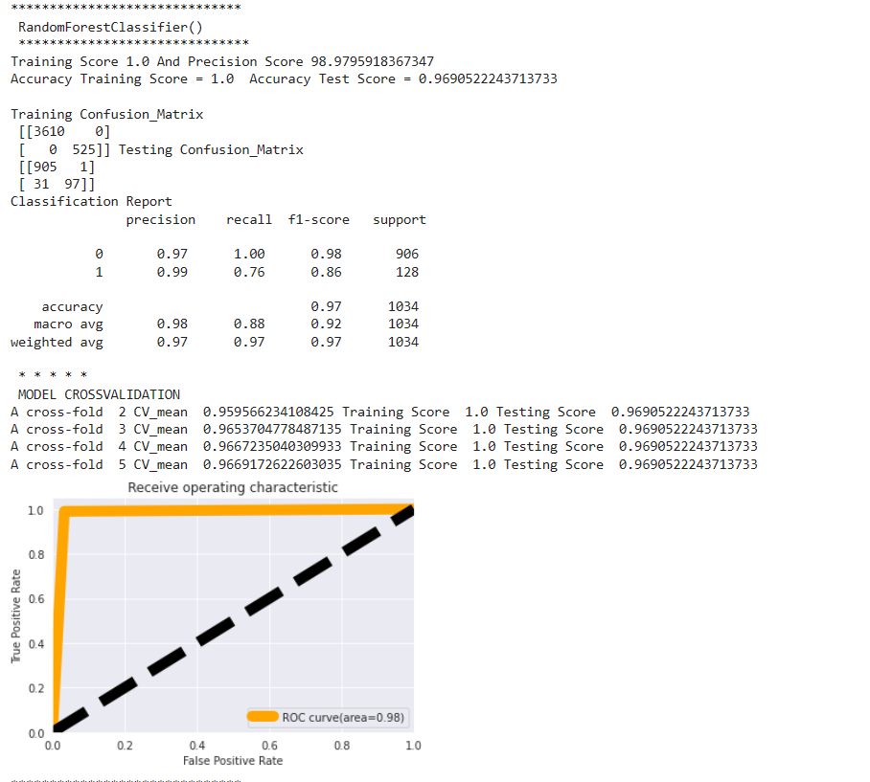
DIFFERENT MODELS WITH THEIR PERFORMANCE:

Slide 26
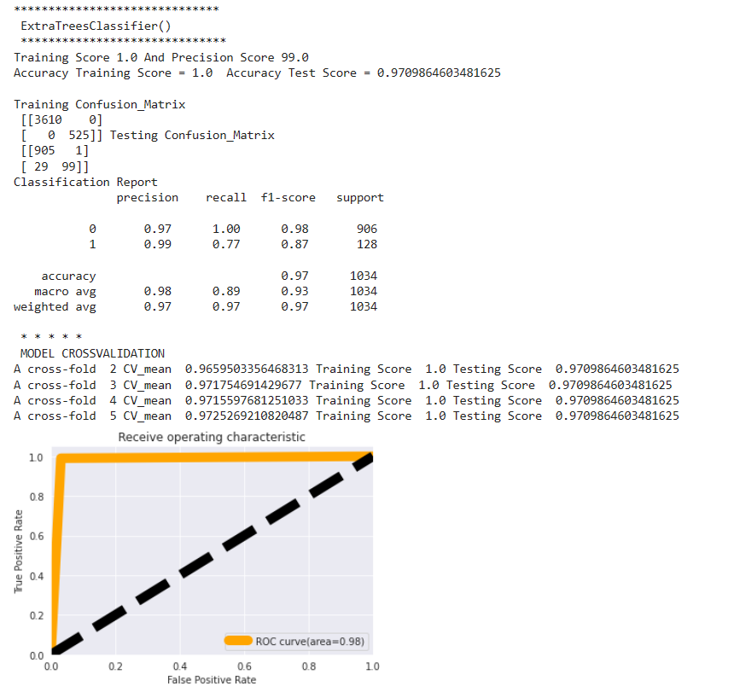

DIFFERENT MODELS WITH THEIR PERFORMANCE:

Slide 27

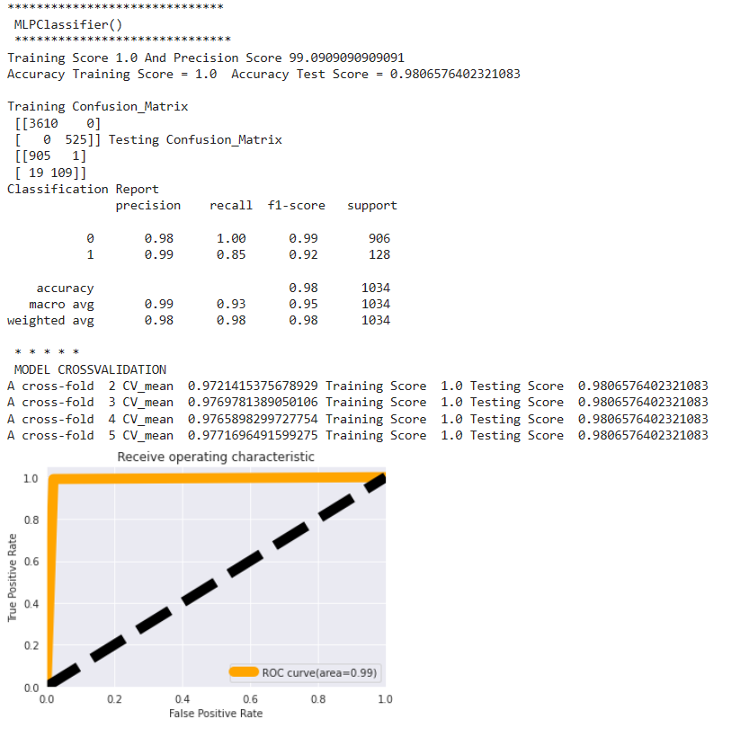
DIFFERENT MODELS WITH THEIR PERFORMANCE:

Slide 28
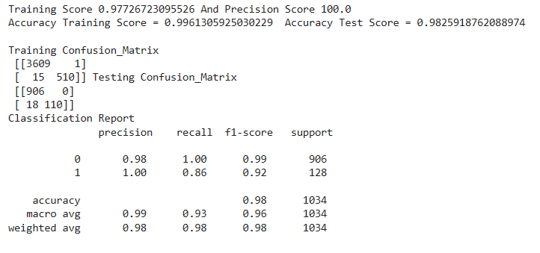
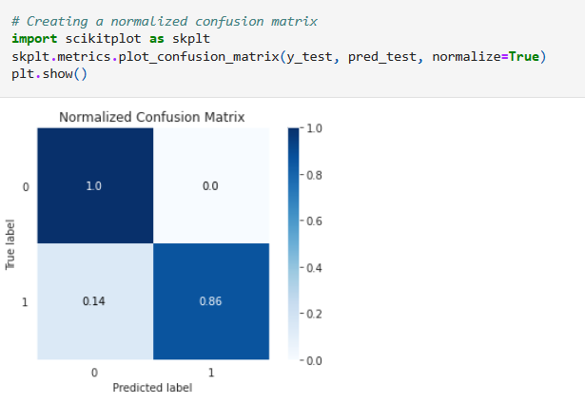
LOGISTIC REGRESSION : HYPER PARAMETER

Slide 29
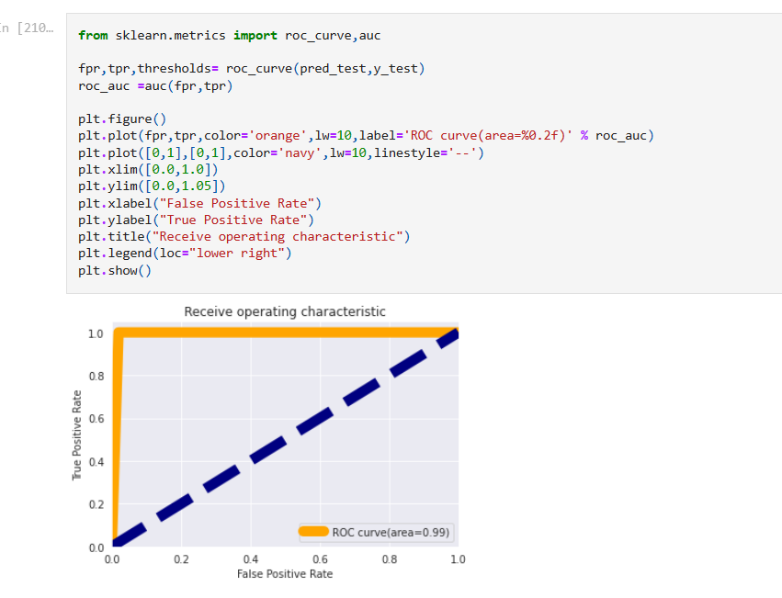
AOC_ROC GRAPH

Slide 30
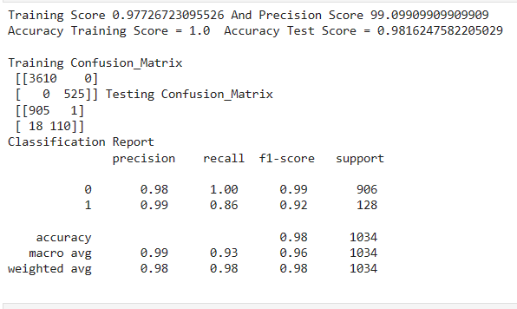
MLP: HYPER PARAMETER

Slide 31
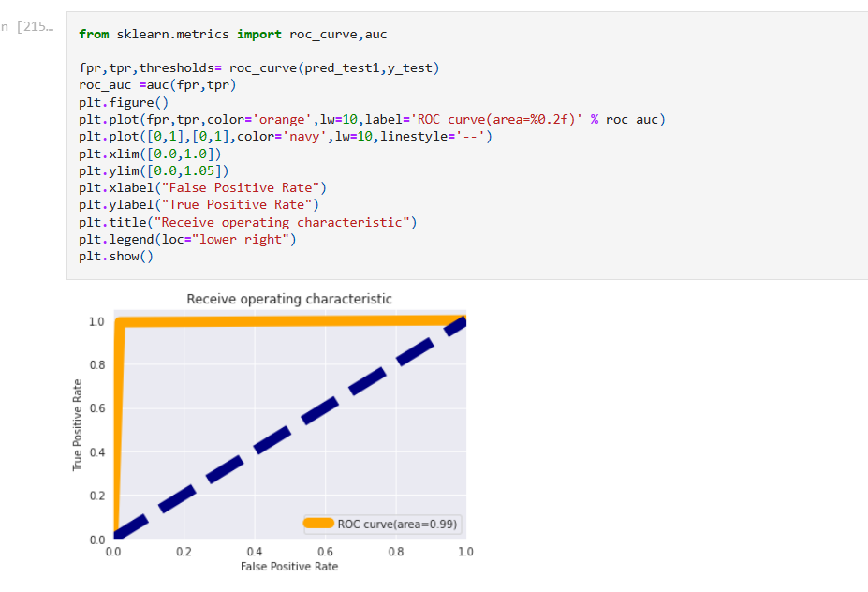
AOC_ROC GRAPH

Slide 32

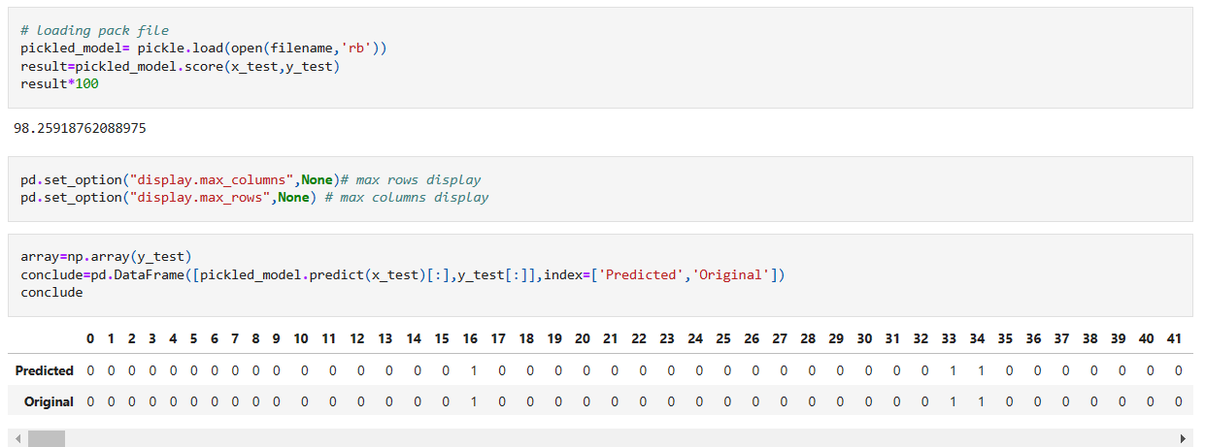
MODEL SAVING
Model Loading:

Slide 33
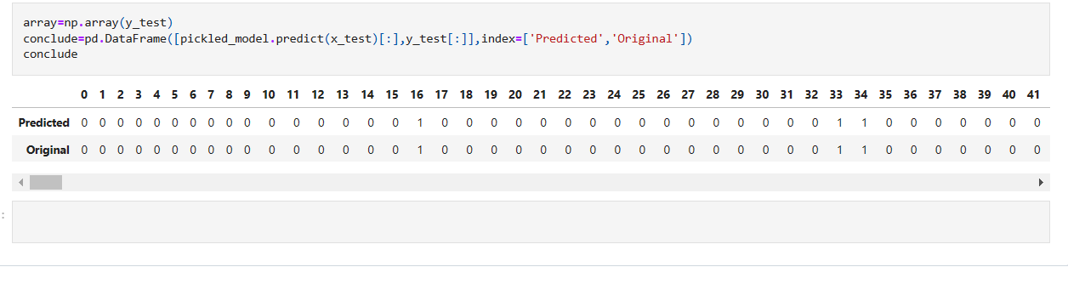
Prediction on Test Data SET SAVING:

Slide 34
CONCLUSION:
In this project report, We have used mainly NLTK library, ML algorithms and seaborn library to understand the relation and interpret the best result.
We have mentioned the step by step procedure to analyze of the Data Set .
Thus we can select the features which are not correlated and are independent in nature.
We calculated the performance of each model using different performance metrics and compared them based on these metrics.
Maximum model selection was focused based on precision Score and Model Accuracy. The Model that worked better on the basis of precision score and accuracy is Random Forest Classifier and Neural Networks Model MLP classifier.
There were very least numbers of feature present in our dataset, I analyzed the data and dropped all the necessary features and finally built the model on message column and target column.
From overall analysis and visualization I come into conclusion that , that text can be cleaned, pre-processed and turned into vectors and can be used as vectors and they can be used in prediction of ham and spam on the other hand sms is one now a days become a one the major source of fraud, Many frauds can be stopped by this simple step.

Slide 35
Final Conclusion
I hope this model will help companies to classify the spam and ham messages.
To conclude, the application of machine learning in SMS spam classification is still at an early stage. I hope this study has moved a small step ahead in providing some methodological and empirical basis contributions.
I think and hope that this will help the consumers to detect the fraud to maximum label and frauds can be brought down to some level.
SMS SPAM Detection is one of the more challenging classification than email spam detection because of the restricted length of SMS, use of regional content and shortcut words and SMS contains less header information

